Slide 1
The World Day of Remembrance for Road Traffic Victims (WDR) 15th November 2015 Abha, Kingdom of Saudi Arabia

Slide 2
Mortality and Morbidity due to Road Traffic Accidents in Saudi Arabia
19 Die Every Day
Four Injured Every one Hour

Slide 3
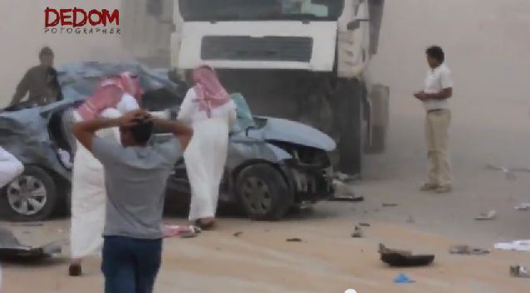
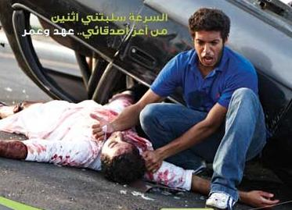
Traffic Accidents
Road traffic accidents
is the fifth leading cause of death
in Saudi Arabia.

Slide 4
Traffic Accidents
Saudi Arabia has recorded in two Decades
4million traffic accidents
86,000 deaths
611,000 injuries

Slide 6
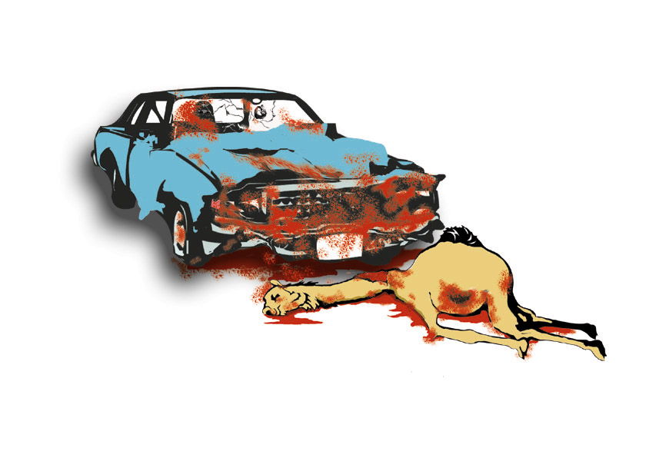
Types of Accidents
Two Cars | 80 %
Accident with fixed object | 6 %
Pedestrian | 3 %
Car Turn Over | 3 %
Animal Collision Accidents | 0.1 %
(Annual Police Statistics Office)

Slide 7
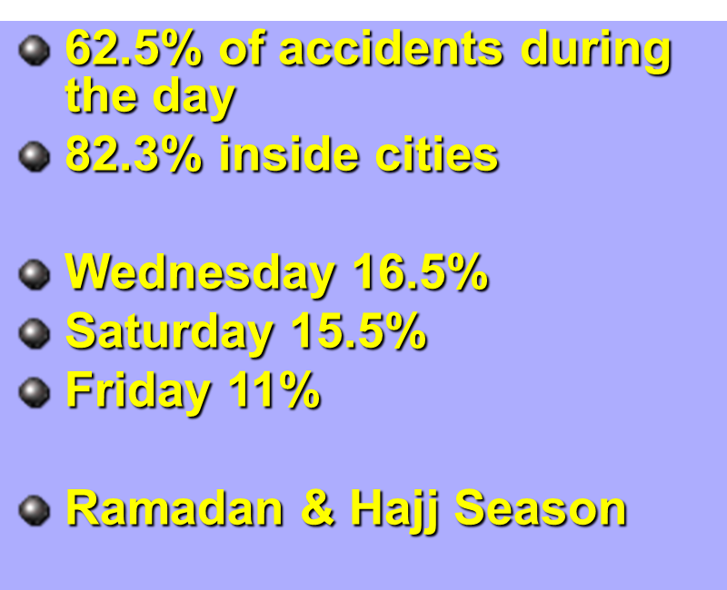
Interesting Facts about Road Traffic Accidents

Slide 8
Prevention of Road Traffic Accidents
Do not use cell phone while driving
To avoid death, use seat belt!
Follow traffic rules, save your future
Alert today – Alive tomorrow.

Slide 9
Prevention of Road Traffic Accidents
Leave sooner, drive slower, live longer.
Slow down! Your family will be waiting for you.
Safe Driving, Saves Lives.
Look every way every day!

Slide 10
Prevention of Road Traffic Accidents
Speed thrills but kills!
Be Bright at Night Stay in Sight
Stop on Red Kids ahead
Don’t Distract the Driver

Slide 11
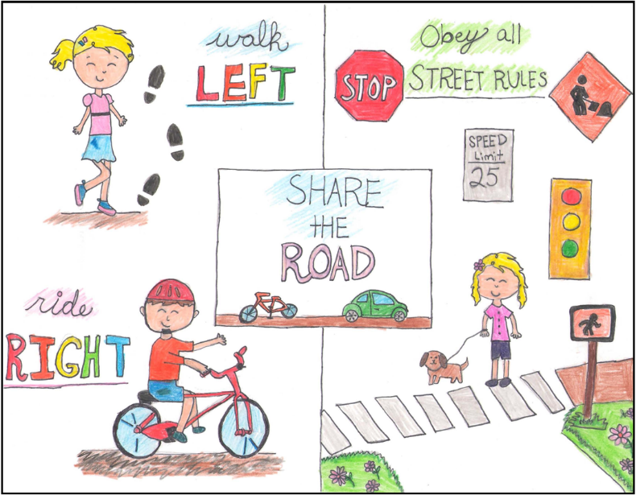
Prevention of Road Traffic Accidents

